Slide 1
The Role of Network Design in Airline Performance:
A Data Driven Approach
Padma Sree Manda
Department of ITDS, University of North Texas
Under the guidance of
Dr. Sourav Chatterjee

Slide 2
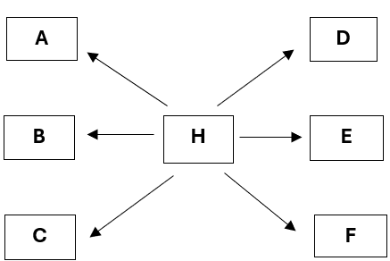
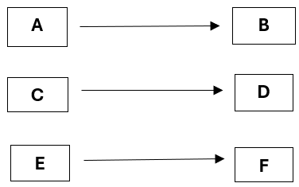
Introduction and Objective
This project explores the impact of airline network structures on operational efficiency and on-time performance.
Key Focus:
Hub-and-spoke vs. Point-to-Point models.
Examining trade-offs between connectivity, passenger convenience, and flexibility.

Slide 3
Dataset Description
Reporting Carrier On-Time Performance:
The grain of the data is per carrier per city pair per flight per date.
Three prominent legacy carriers namely, Delta Airlines, American Airlines and United Airlines, along with Southwest Airlines.
For analysis purpose, data has been restricted to 2018 yearly data which has more than 3.5M observations.
Metrics include delays, cancellations, distance, and departure/arrival times.
Target – Arrival Delay
T-100 Segment Traffic Data:
The grain of the data is per carrier per city pair per month per year.
The data has been restricted to four main airlines as discussed above.
For analysis purpose, data has been restricted to 2018 – 2023 period.
Metrics include payload, seats, distance, and stage length.
Derived indicators – Load Factor, ASM, RPM, etc.
Sources: The Bureau of Transportation Statistics website at
https://www.transtats.bts.gov/DL_SelectFields.aspx?gnoyr_VQ=FGJ&QO_fu146_anzr=b0-gvzr and
https://www.transtats.bts.gov/DL_SelectFields.aspx?gnoyr_VQ=GDM&QO_fu146_anzr=Nv4%20Pn44vr45

Slide 4
Models
Regression Analysis
Network Analysis
The process of analyzing the relationship between dependent (target) variable and one or more independent (predictors) variables.
Machine Learning Models such as Linear Regression and Decision Tree Regressor are used.
In this Arrival Delay is the target variables and other columns are taken as predictors.
Feature Selection:
Statistical Process (Human approach)
Machine Learning Based (Automatic)
Network analysis is a set of techniques that utilize network theory to analyze social network influences by mapping relationships among entities based on their relative proximity and interconnectedness.
Centrality Measures:
Degree
Betweenness
Closeness
Eigenvector
Visualizing Airline Networks using network graphs or ego graphs.

Slide 5
Regression Analysis – Results
Model | Feature Selection Process | Train Score | Test Score
Linear Regression | Statistical (Human) | 0.9572 | 0.9577
 | Machine (Automatic) | 0.9614 | 0.9620
Decision Tree Regressor | Statistical (Human) | 0.9821 | 0.9813
(Max Depth = 13) | Machine (Automatic) | 0.9836 | 0.9829

Slide 6
Regression Analysis – Decision Tree Regressor
The algorithm identifies the features that most effectively segregate the data into separate groups at each stage, resulting in a tree-like structure delineating the decision rules.
A key metric employed in decision tree algorithms is entropy, which serves to measure impurity or disorder within the data subsets throughout the process of constructing the tree.
Entropy quantifies the level of uncertainty or randomness intrinsic to a set of data points and is integral to the computation of information gain.
DEP_DELAY is a key predictor

Slide 7
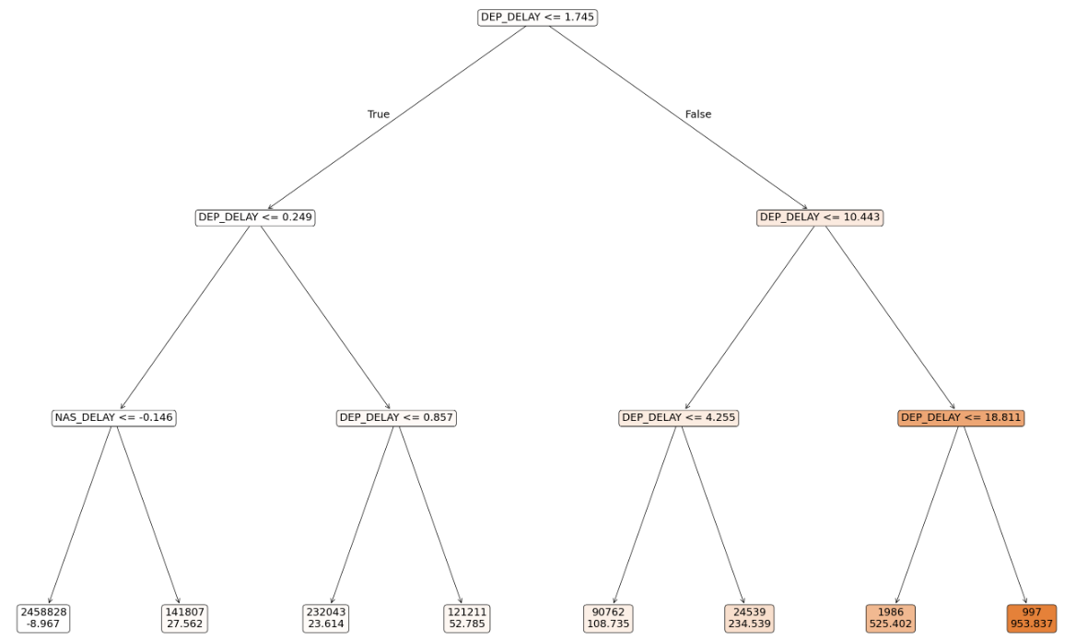
Regression Analysis – Decision Tree Regressor (cont.)

Slide 8
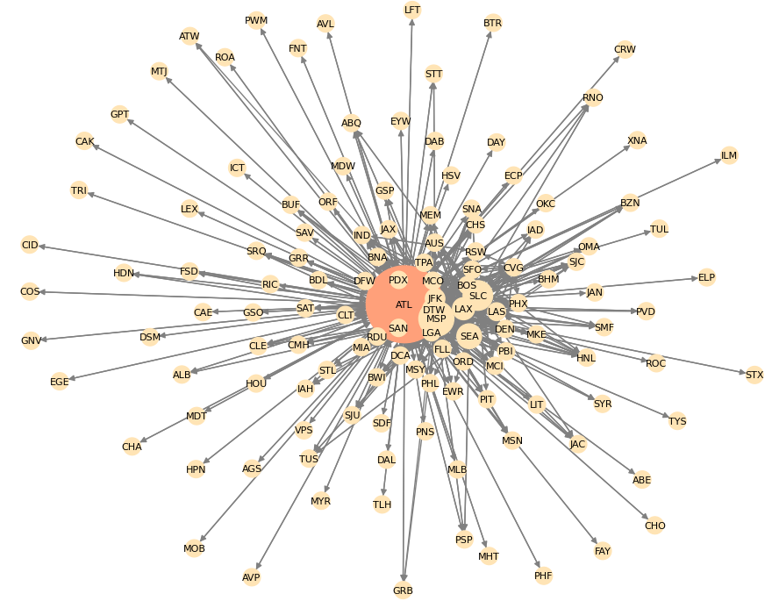
Network Analysis
Network graphs provide a visual and analytical presentation of relationship between the airports which are called nodes and the routes connecting them as edges.
Also, the weight of the line represents the frequency of flights along a route.
Notes:
Nodes: Represents the airports in each airline network.
Edges: Direct flight connections between two airports.
Weights: Number or the frequency of flights along the route.

Slide 9
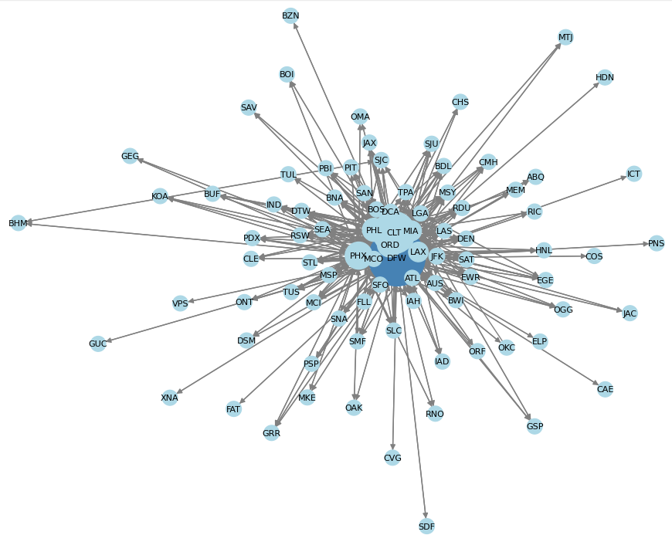


Slide 10


Slide 11
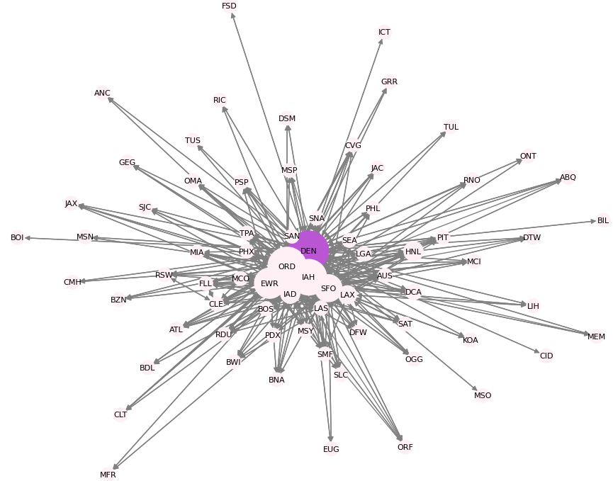


Slide 12
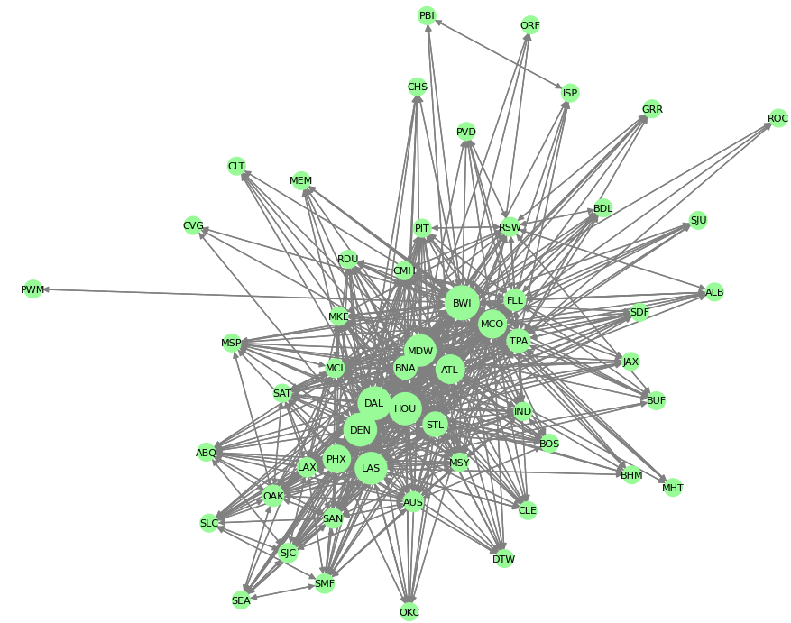


Slide 13
Network Analysis – Centrality Measures
To gain insights into the structure of each network graph, several measures have been used.
Degree Centrality – Number of Direct Connections. Major hubs will have higher number
Betweenness Centrality – Measure of how frequently a node appears in the shortest path between all pair of nodes
Closeness Centrality – Nodes that contribute to the efficient pathways within the network will exhibit higher values of this measure
Eigenvector Centrality – Measure of the influence that a node yields within the network. In essence, nodes connected to other significant nodes tend to have a higher value.

Slide 14
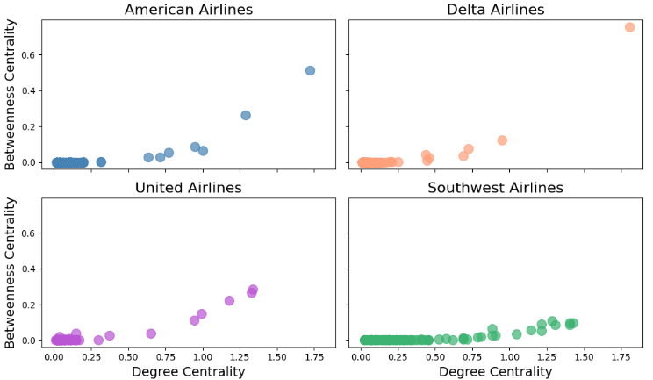
Degree Centrality vs Betweenness Centrality
Southwest Airlines has a significantly lower betweenness centrality value compared to legacy carriers.
This difference may stem from the fact that high-traffic airports are interconnected rather than being organized around a central hub, which characterizes a hub-and-spoke system.
The interconnected set of airports results in a high degree of centrality but not necessarily frequent inclusion in the shortest paths, resulting in a lower betweenness value

Slide 15
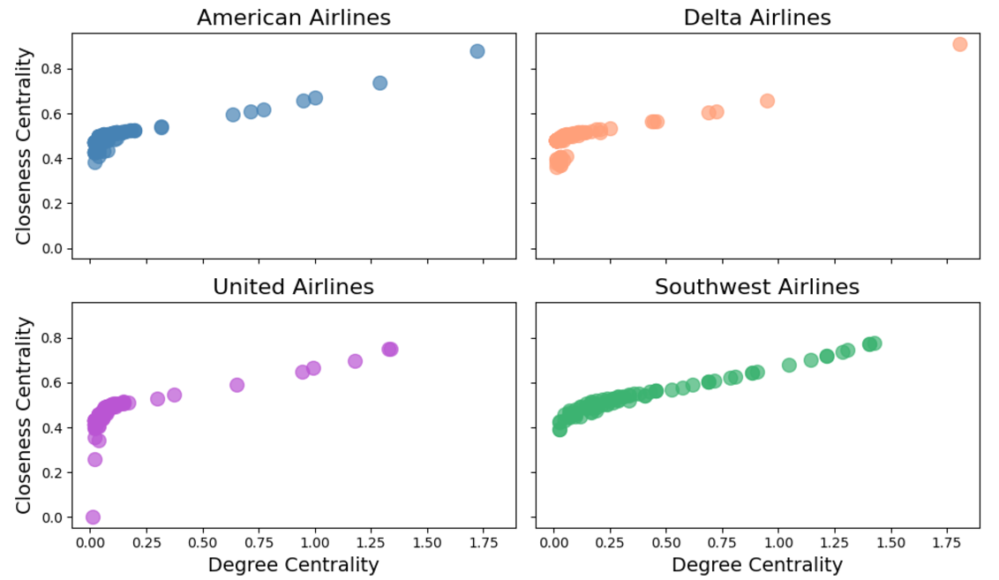
Degree Centrality vs Closeness Centrality
No nodes in Southwest Airlines exhibit low closeness values, suggesting that every airport is connected to others via efficient pathways, even if they are linked to fewer nodes.
All nodes across the legacy airlines display at least mid-range closeness values, except for a specific node within United Airlines that records both degree and closeness values of zero.
This node is a spoke airport with minimal connections. An airport that is connected to another spoke airport instead of a hub.

Slide 16
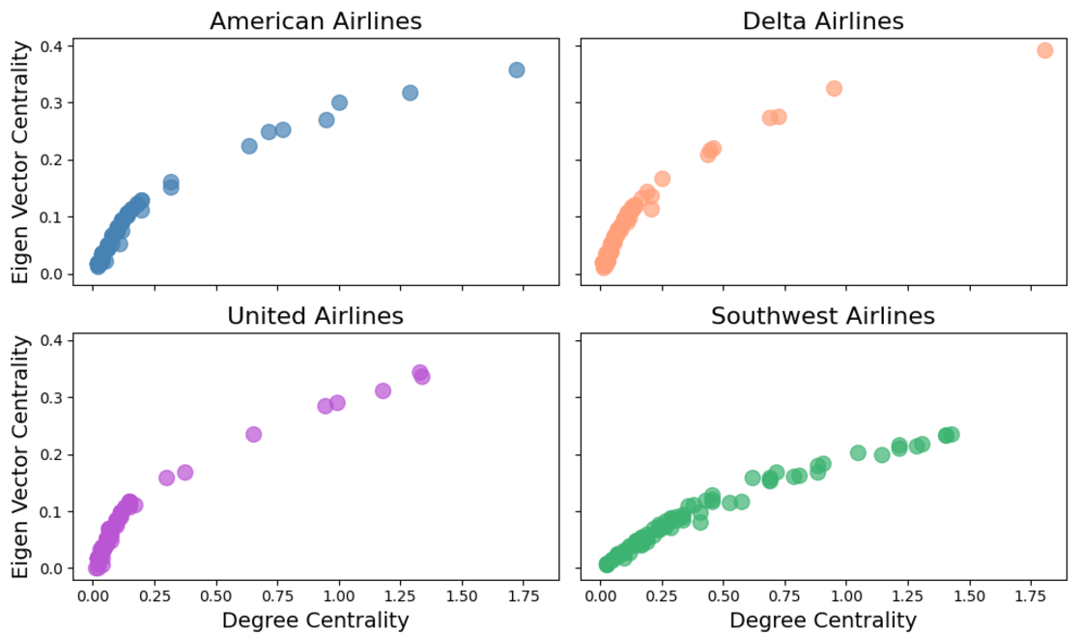
Degree Centrality vs Eigenvector Centrality
For Southwest Airlines, it is important to note that eigenvector values are lower compared to those of other airlines, which can be attributed to the different network structure employed.
However, nodes with high degree centrality also have high eigenvector values. This may be due to the interconnected nature of these nodes, enhancing their influence relative to airports that exhibit less interconnectivity.
For legacy carriers, hubs and regional hubs have high eigenvector values whereas spokes have low values.

Slide 17
Conclusions
The key difference between the network structures namely Hub-and-Spoke and Point-to-Point have been understood based on various factors such as delays and various centrality measures.
From the regression results, all the models demonstrate a good fit as the test scores are close to the training scores. Decision Tree Regressor outperforms Linear Regression and provides other information relating to key predictors.
Southwest has a lower betweenness centrality value compared to other major carriers
Delta Airlines shows a traditional Hub-and-Spoke network structure with only one major hub having both highest Degree and Betweenness Centrality.
Nodes showing very low closeness centrality value could be an airport that works as a spoke connected to another spoke in the Hub-and-Spoke network. This phenomenon is observed in United Airlines.
Major Hubs and other Regional Hubs show high eigenvector values whereas the spoke nodes show a low eigenvector values. It is to be noted that Southwest eigenvector values are lower compared to other airlines in the industry.

Slide 18
Future Research
Optimization of Hybrid Models: Identifying pairs that should be hub dependent and pairs that could benefit from direct routes.
Incorporating Passenger Preferences: Predicting routes that would attract more passengers. Developing recommendation systems for dynamic route offerings.

Slide 19
References
Bureau of Transportation Statistics datasets.
Airline Networks: A Comparison of Hub-and-Spoke and Point-to-Point Systems.
Domestic airlines in the US (Industry report 48111B) – IBIS World.

Slide 20
Questions/Comments

Slide 21
Appendix

Slide 22
Regression Analysis – Feature Selection
Statistical Approach
Machine Learning Approach
Needs Human Intervention.
Uses Statsmodel OLS model to train the data.
As per the summary report based on hypothesis testing, only the predictors that are statistically significant are chosen.
Statistical significance using p – values < 0.05.
Selected Features –
Dep Delay, Network, Taxi in/out, types of delays, etc.
Total 12 predictors have been selected.
Automatic process without human intervention.
Uses Sequential Feature Selector process in Forward direction.
The model selects the best possible features or predictors by optimizing the R squared value.
Selected Features –
Dep Delay, Distance, Taxi in/out, Network, different types of delays, CRS Elapsed time, Departure/Arrival time blks, etc.
50 predictors have been chosen by the model.

Slide 23
Regression Analysis – Linear Regression
The objective of this machine-learning model is to identify the optimal set of model parameters (coefficients) that minimizes the prediction error on the training dataset.
This process is frequently accomplished through the application of optimization algorithms, and the problem is commonly referred to as the “Least Squares” optimization problem.
In the realm of linear regression, the Mean Squared Error (MSE) serves as the predominant objective function.
MSE quantifies the mean of the squared differences between the predicted values and the actual target values within the training dataset, thereby providing a measure of the model’s accuracy.
The major limitation of the linear regression model is that predictors and the target should be linearly related.

Slide 24
Additional Conclusions
The analysis highlights how airlines are evolving to stay competitive.
Legacy carriers are adopting features from low-cost airlines to attract budget-conscious travelers, while low-cost carriers are expanding into underserved markets.
Loyalty programs, technological advancements, and targeted service expansions demonstrate the adaptability of both models in a changing aviation landscape.
Future Research:
Optimization of Hybrid Models: Identifying pairs that should be hub dependent and pairs that could benefit from direct routes.
Incorporating Passenger Preferences: Predicting routes that would attract more passengers. Developing recommendation systems for dynamic route offerings.

